Slide 1
The Dosage Dependent Suppressive Effect of Curcumin on Jurkat Cells
Christie Ra, Luke Monsma, Eduardo Aguilar, Katelyn Hoekema
Biology 333 L

Slide 2
Table of contents
01
03
Background + Hypothesis
Results
02
04
Discussion
Methods and Materials

Slide 3
01
Background + Hypothesis
Curcumin and Jurkat Cells

Slide 4
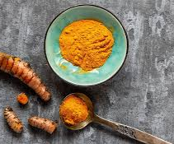
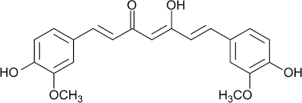
Background: Curcumin
It is cooking spice typically used in Asian Cuisine
Historically used in herbal medicine
The active ingredient in turmeric
Understood to have anti-inflammatory, antioxidant and antiviral pharmacological effects
Previous research suggests inhibition of cytokines and NF-kB ^{1,2}
Notes:
https://pmc.ncbi.nlm.nih.gov/articles/PMC7522354/
https://www.jbc.org/article/S0021-9258(20)65432-1/fulltext

Slide 5
Immortalized Homosapien T cells
Isolated from peripheral blood sample
A young boy with Leukemia
Commonly used in laboratory settings
Background: Jurkat
Notes:
https://www.creative-biogene.com/support/Jurkat.html

Slide 6
Hypothesis
Question
Hypothesis
Will curcumin have a dosage dependent suppressive effect on Jurkat cell activation?
Curcumin will produce a dosage dependent suppression of Jurkat cell activation

Slide 7
02
Methods and Materials

Slide 8
Materials
PMA and Ionomycin
Antibody
Curcumin Stock Solution
10 mg of Curcumin in 1 mL of DMSO
Filtered the stock using a 0.22 um filter.
Stored at room temperature
Curcumin from Curcuma longa (Turmeric)
1 uL of PMA into 24 uL of media
40 ng/mL
1 uL of 2 mg/mL of Ionomycin
2 ug/mL
CD69
Expressed on newly activated lymphocytes
Early activation marker detected within 3 hrs
Expression drops over time
Notes:
https://pmc.ncbi.nlm.nih.gov/articles/PMC10607364/#:~:text=CD%20(cluster%20of%20differentiation)%2069,lymphocytes%20and%20regulatory%20T%20cells.

Slide 9
Well Diagram
Cells PMA/Ionomycin | Curcumin
200,000 Cells No Activation | None
400,000 Cells PMA and Ionomycin Added | 0 ug/mL
400,000 Cells PMA and Ionomycin Added | 5 ug/mL
400,000 Cells PMA and Ionomycin Added | 15 ug/mL
Notes:
We had 10 ug/mL and we also added 1.5 uL of DMSO to the 0ug/mL

Slide 10
Methods - Plating and Analysis Timeline
Step 3
Step 2
Step 4
Step 1
Step 5
Jurkat Cell surfaces were stained with CD69 Antibody for 15 minutes
PMA and Ionomycin were added to wells, cells were incubated for 1 day
Cells were washed and data collected through the Flow Cytometer.
Plated Media, Cells and Curcumin Stock/DMSO and incubated for 1 hour
Analyzed using Floreada and graphed on excel.
Notes:
Christie

Slide 11
Results
03
Analysis, Activation, and Viability

Slide 12
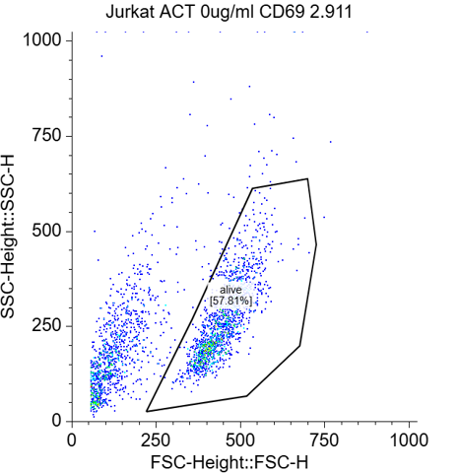
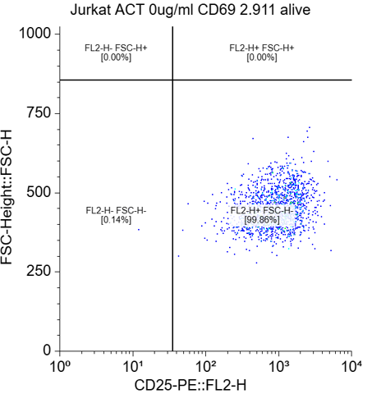
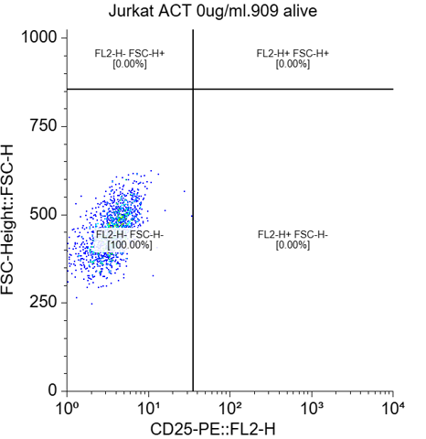
Flow Cytometry Analysis
90%
42%
64%
Live gating for a trial of
0 ug/mL turmeric added
Quadrants for the same trial measuring activity
Quadrants were based respective concentrations with no CD69
Notes:
Luke

Slide 13
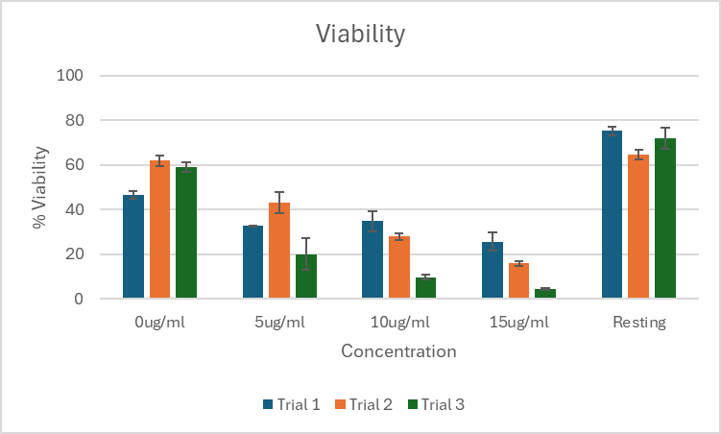
Viability
Result:
Higher curcumin concentration had lower viability
Notes:
Luke

Slide 14
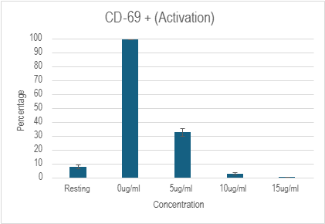
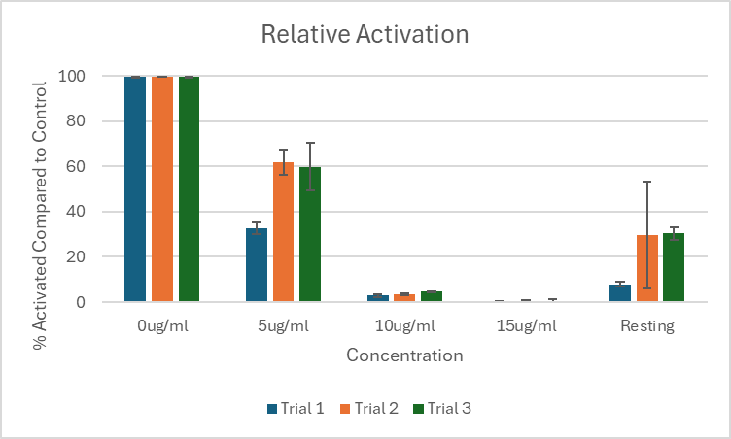
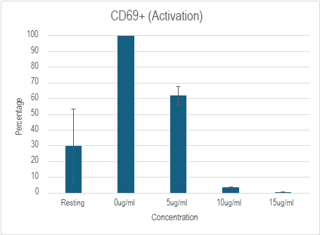
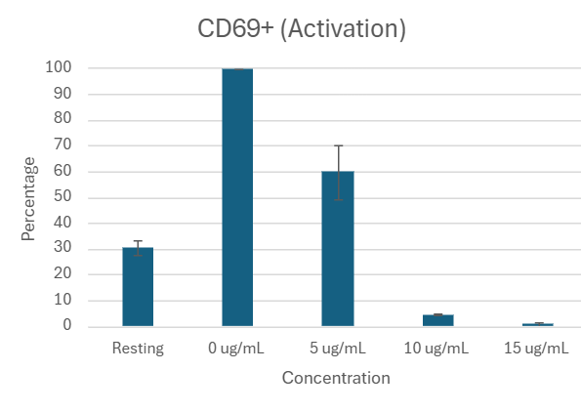
Activation
Result:
Increasing concentrations of curcumin decreased activation levels of cells.
With all trials combined, the differences between Resting and 0ug, as well as 0ug and 5ug were significant p<0.001
Notes:
Luke

Slide 15
Discussion
04
Conclusions, Questions, and Concerns

Slide 16
Conclusions
1
2
3
Curcumin produces a dosage dependent suppression of Jurkat cell activation
High concentrations of Curcumin may have cytotoxic effects on Jurkat cells leading to decreased viability
Baseline expression of CD69 in resting cells even in absence of activation signals.
Notes:
Eduardo (?)

Slide 17
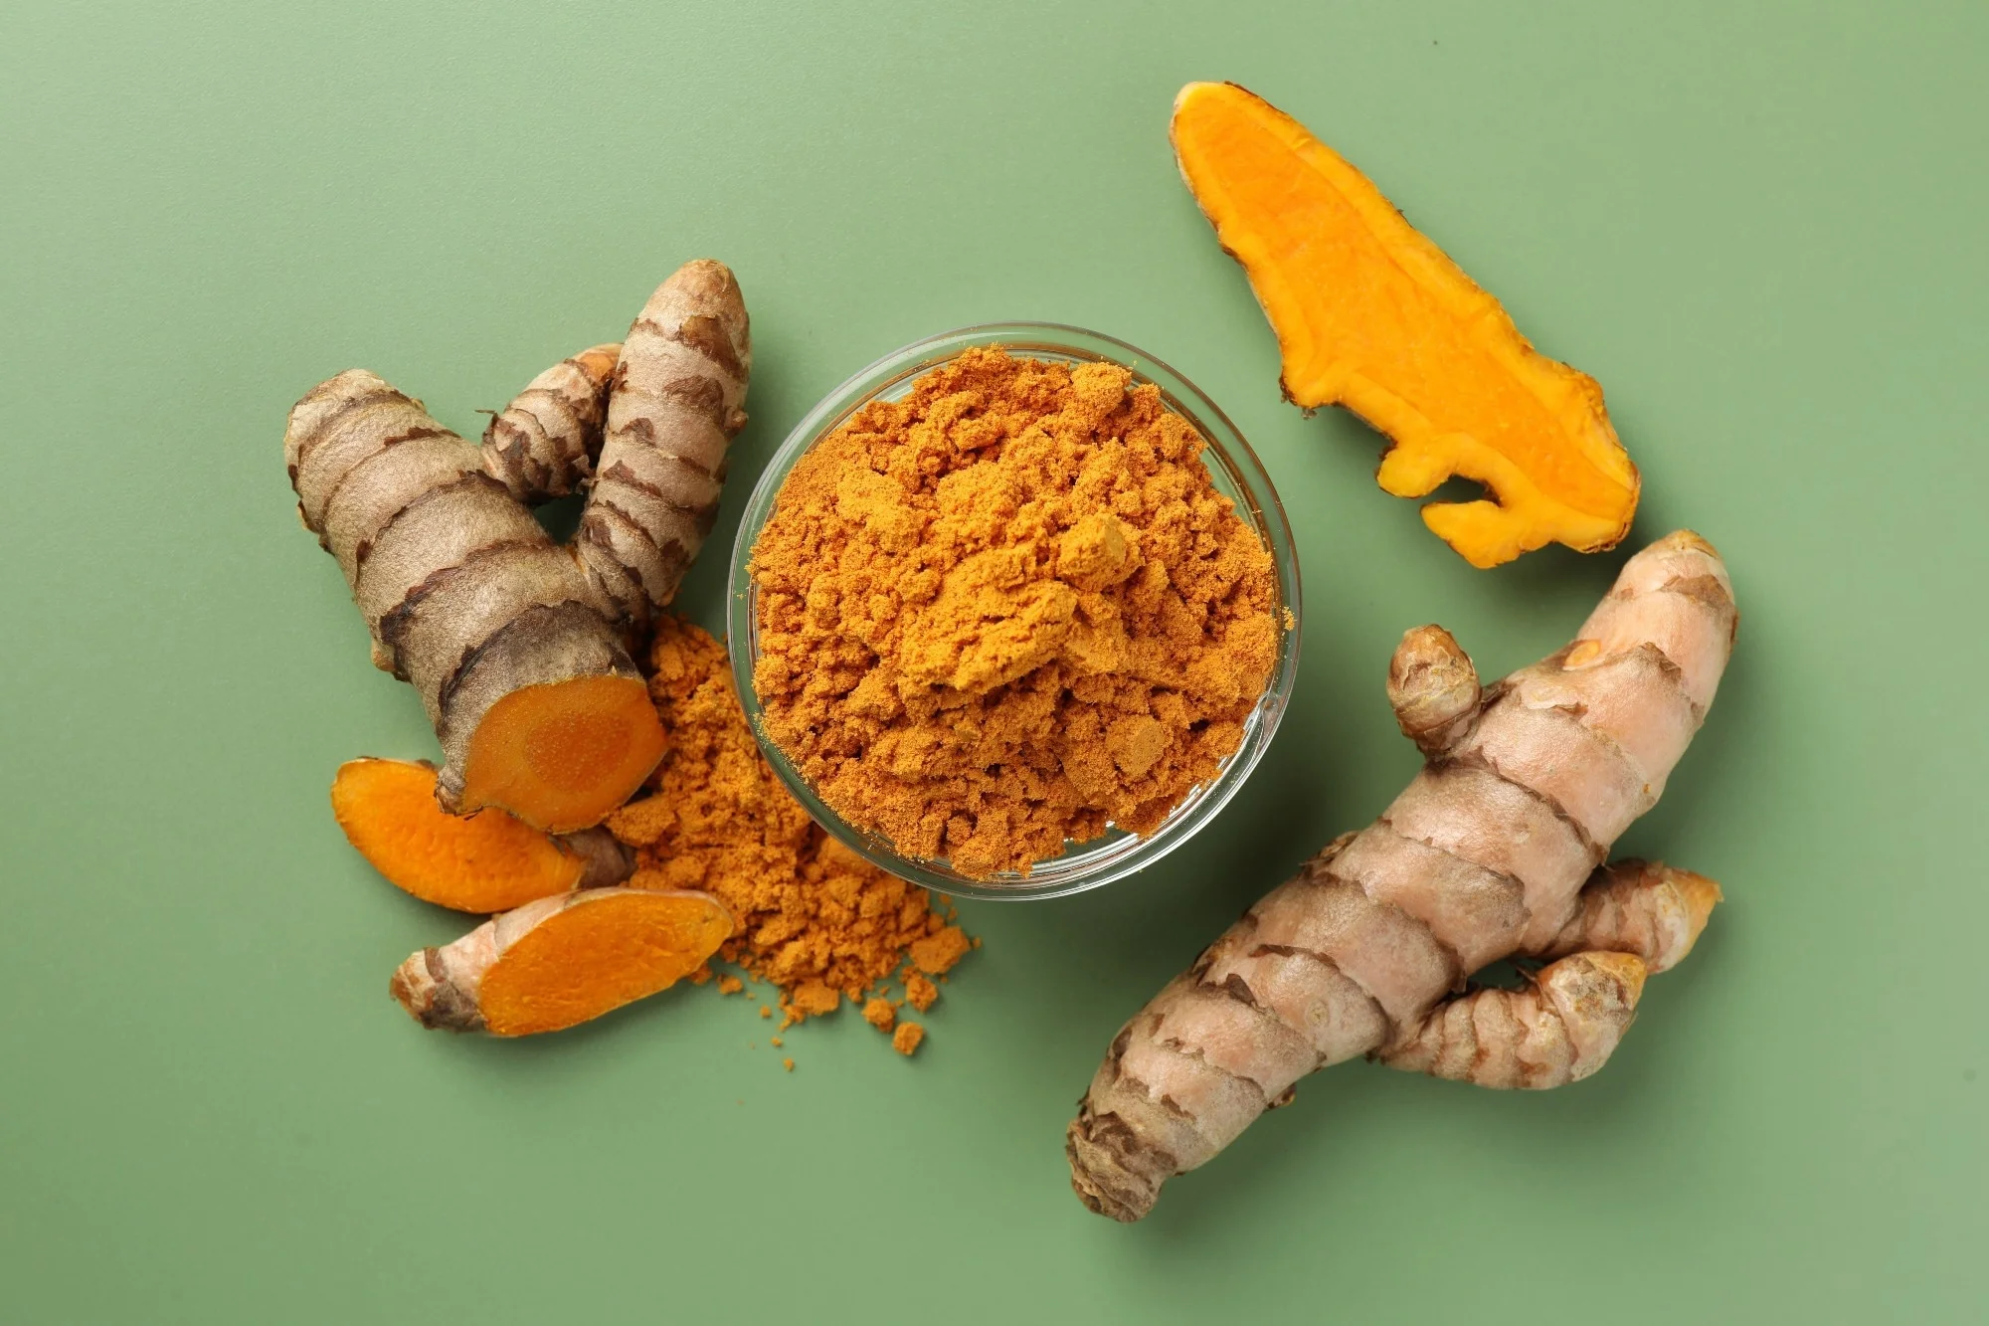
Questions and Concerns
Concerns:
Stock Curcumin
Change in Ab
Weird Resting well in trial 2
Questions:
Effectiveness compared to other substances that lower activation
Notes:
Eduardo (?)

Slide 18
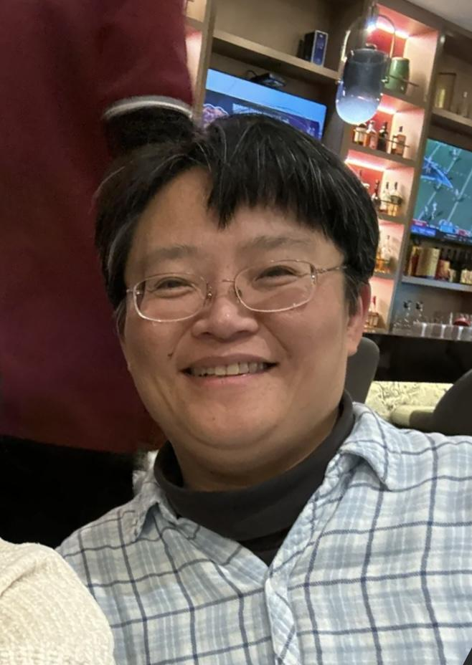
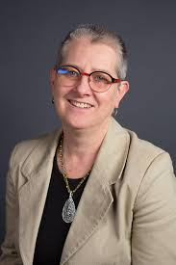
Acknowledgements
Prof. Shen
Prof. Keen

Slide 19
Sources
Adamczyk, M.; Bartosińska, J.; Raczkiewicz, D.; Kowal, M.; Surdacka, A.; Krasowska, D.; Michalak-Stoma, A.; Krasowska, D. The Expression of Activation Markers CD25 and CD69 Increases during Biologic Treatment of Psoriasis. JCM 2023, 12 (20), 6573. https://doi.org/10.3390/jcm12206573.
Kliem, C.; Merling, A.; Giaisi, M.; Köhler, R.; Krammer, P. H.; Li-Weber, M. Curcumin Suppresses T Cell Activation by Blocking Ca2+ Mobilization and Nuclear Factor of Activated T Cells (NFAT) Activation. Journal of Biological Chemistry 2012, 287 (13), 10200–10209. https://doi.org/10.1074/jbc.M111.318733.
Sharifi-Rad, J.; Rayess, Y. E.; Rizk, A. A.; Sadaka, C.; Zgheib, R.; Zam, W.; Sestito, S.; Rapposelli, S.; Neffe-Skocińska, K.; Zielińska, D.; Salehi, B.; Setzer, W. N.; Dosoky, N. S.; Taheri, Y.; El Beyrouthy, M.; Martorell, M.; Ostrander, E. A.; Suleria, H. A. R.; Cho, W. C.; Maroyi, A.; Martins, N. Turmeric and Its Major Compound Curcumin on Health: Bioactive Effects and Safety Profiles for Food, Pharmaceutical, Biotechnological and Medicinal Applications. Front. Pharmacol. 2020, 11, 01021. https://doi.org/10.3389/fphar.2020.01021.
https://www.creative-biogene.com/support/Jurkat.html
Notes:
Need to format

Slide 20
Thank You
For Listening
Any Questions?

